Slide 1
WASHINGTON STATE CHARTER SCHOOL COMMISSION and
CREDO at STANFORD UNIVERSITY
SHARING THE RESPONSIBILITY OF PARENT ENGAGEMENT
Joshua Halsey, Executive Director
Lauren J. Bierbaum, PhD, Senior Research Analyst
April 27, 2018

Slide 2
Goals and Agenda
Goals
Explore current family engagement practices;
Deepen understanding of the research regarding family engagement and improved student outcomes; and
Identify ways to use research outcomes to strengthen family engagement practice.
AGENDA
Overview of Session
Exploring the Why? Why are we talking about Family Engagement?
Summary of Research on the Impact of Family Engagement on Student Outcomes
Revisiting Charter Application Family Engagement Plans
Identify Next Steps and Close
WASHINGTON STATE CHARTER SCHOOL COMMISSION
PAGE 2
Notes:
Ask participants for any additional goals

Slide 3
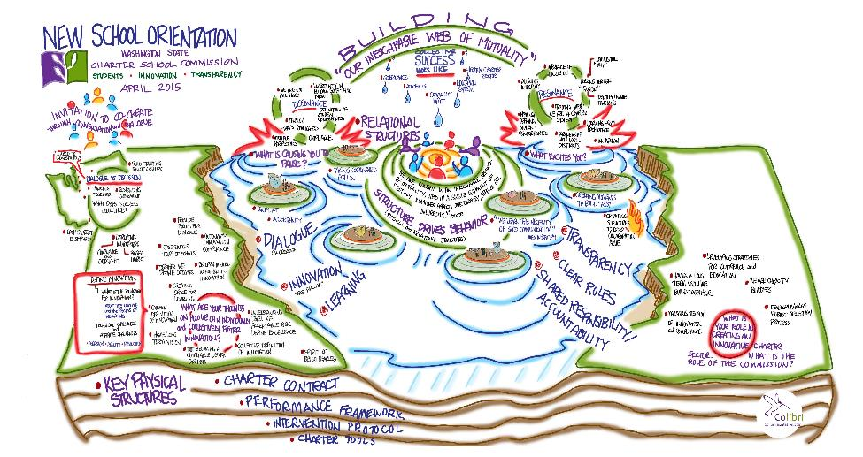
Commission Guiding Principles
WASHINGTON STATE CHARTER SCHOOL COMMISSION
PAGE 3

Slide 4
Exploring the Why
Why are we talking about Family/Parent Engagement?
There is strong research that ties family engagement outcomes to student outcomes;
Each school has a mission-specific goal tied to family engagement; and
All schools articulate that family engagement is critical component of their school and have clear plans for engagement in their charter application.
WASHINGTON STATE CHARTER SCHOOL COMMISSION
PAGE 4
Notes:
Be careful with the specter of the hammer
Reinforce the co-creative stance
Asking questions and being open, no right/wrong

Slide 5
Family Engagement: The Research
Family engagement positively relates to student achievement.
On average:
  Engagement becomes more important as children reach adolescence
  Engagement boosts global student outcome measures more than interim benchmarks
  Positive impact of engagement holds true across grade level and race/ethnicity
WASHINGTON STATE CHARTER SCHOOL COMMISSION
PAGE 5

Slide 6
Family Engagement: The Research
What family engagement activities support students?
  Holding high expectations
  Authentic communication with school
  Literacy support
What matters less?
  Homework monitoring/support at home
  Family participation in school events
WASHINGTON STATE CHARTER SCHOOL COMMISSION
PAGE 6
Notes:
Have the Social Capital and Social Control in back pocket to help with common language/understanding

Slide 7
Family Engagement: Conditions for Success
Top-to-bottom commitment
Families as partners
Alignment to school goals
Resources (including appropriate staffing)
Welcoming policies and climate
Evaluation
YouthForce NOLA Family Engagement Toolkit: http://urbanleaguela.org/ul/family-engagement-toolkit/
WASHINGTON STATE CHARTER SCHOOL COMMISSION
PAGE 7

Slide 8
Family Engagement: A Theory of Action
What is a Theory of Action?
Why have a Theory of Action?
Do you already have one?
WASHINGTON STATE CHARTER SCHOOL COMMISSION
PAGE 5

Slide 9
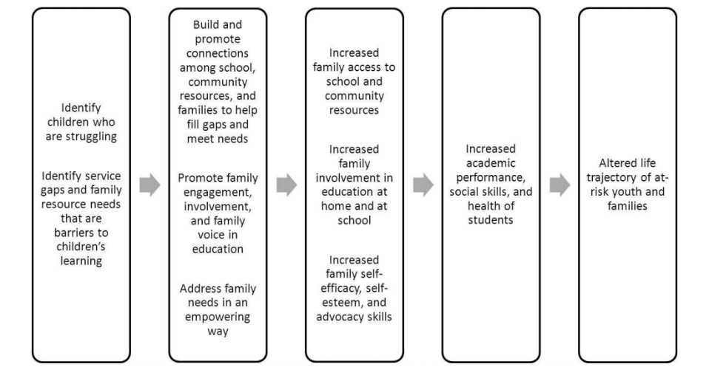
Family Engagement: A Theory of Action
Pullman et al., 2011
WASHINGTON STATE CHARTER SCHOOL COMMISSION
PAGE 5

Slide 10
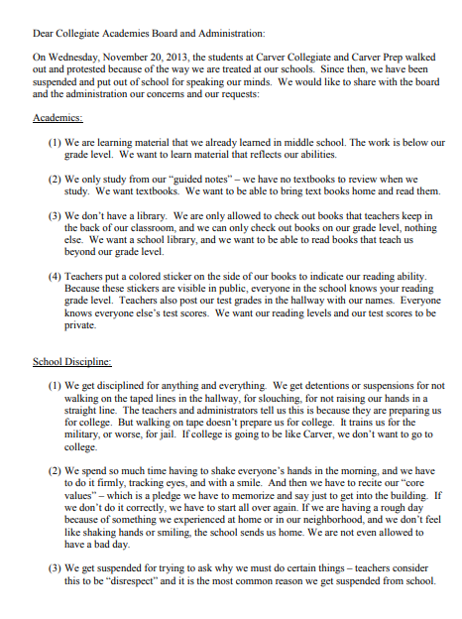
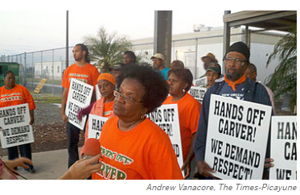
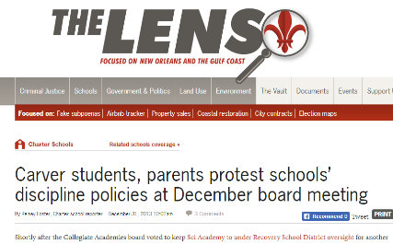
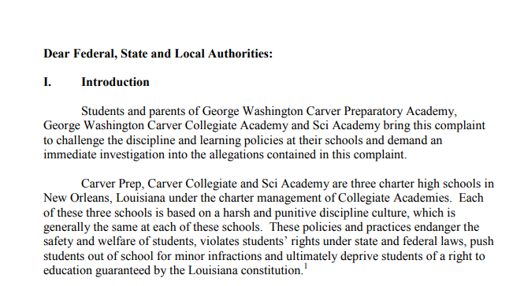
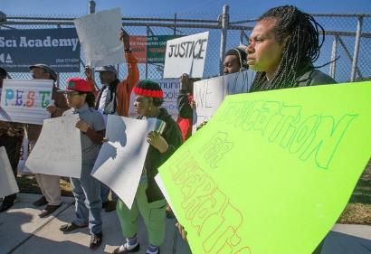
Collegiate Academies: A Case Study
WASHINGTON STATE CHARTER SCHOOL COMMISSION
PAGE 10
Notes:
Back pocket: WA Charter Sector has experienced significant changes in school leadership

Slide 11
Collegiate Academies: A Case Study
What can we learn from Collegiate’s experience?
School failure is community trauma
Listen for the meaning
Find shared goals
Take an asset-based approach
Identify appropriate roles
Nurture!
WASHINGTON STATE CHARTER SCHOOL COMMISSION
PAGE 11
Notes:
Pull some citation on school closure as trauma
Think about questions that we might pose to stimulate dialogue and sharing

Slide 12
Washington State: Our value-add
Family engagement at the secondary level
Sectorwide commitment baked in
Understanding systemwide approaches and supports
Strengthening definitions, indicators, and tools
Multi-dimensional approach to student success
WASHINGTON STATE CHARTER SCHOOL COMMISSION
PAGE 12
Notes:
Lauren takes lead on 1st, 4th and 5th
Josh take 2nd and 3rd
Bing contribute 2nd 3rd 4th

Slide 13
Reflections: Charter Application Family Engagement Plan
At your table tops, please identify a spokesperson to share out the highlights of your conversation regarding the following questions. Highlights are things, concepts, and learnings that you feel others would benefit from hearing about:
How has what we planned to do in our application changed? Why?
How do we know that what we are doing is effective?
How do we incorporate what we learn from our engagement activities get transferred into the various function/departments of our schools?
WASHINGTON STATE CHARTER SCHOOL COMMISSION
PAGE 13

Slide 14
Moving Forward
Individually or with your team, please reflect and then discuss the following questions:
Based upon this session’s content and dialogue, what are some key take-aways for you and your team?
How can we collectively support your ongoing family engagement efforts? We encourage you to also consider how key barriers can be addressed and what resources are needed.
WASHINGTON STATE CHARTER SCHOOL COMMISSION
PAGE 14

Slide 15
Family Engagement Learning Resources
Building a Theory of Change/Action:
Demystifying the Theory of Change/Theory of Action Process: https://ssir.org/articles/entry/demystifying_the_theory_of_change_process
The Importance of Logic Models: http://www.socialsolutions.com/blog/the-importance-of-logic-models-and-theories-f-change/
Logic Model Development Guide: https://www.wkkf.org/resource-directory/resource/2006/02/wk-kellogg-foundation-logic-model-development-guide
Theory of Change Guide (up to p.9): https://www.clinks.org/sites/default/files/TheoryofChangeGuide.pdf
Pullman, M. et al. (2011) Theory, programs, and research on school-based family support. [White paper] Division of Public Behavioral Health and Justice Policy, University of Washington; accessed 23 April 2018
Holley (2016) Equitable and inclusive civic engagement. [White paper] Kirwan Institute, Ohio State University: http://kirwaninstitute.osu.edu/wp-content/uploads/2016/05/ki-civic-engagement.pdf
Family Engagement Impacts:
Castro, M. et al. (2015) Parental involvement on student academic achievement: A meta-analysis. Educational Research Review Volume 14; p. 33–46
Jeynes, W.H. (2007) The Relationship Between Parental Involvement and Urban Secondary School Student Academic Achievement A Meta-Analysis. Urban Education Volume 42 Number 1; p. 82-110
Wilder, S. (2014) Effects of parental involvement on academic achievement: a meta-synthesis. Educational Review Volume 66 Number 3; p. 377–397
YouthForce NOLA Family Engagement Toolkit: http://urbanleaguela.org/ul/family-engagement-toolkit/
WASHINGTON STATE CHARTER SCHOOL COMMISSION
PAGE 15

Slide 16
Family Engagement Learning Resources
School Closure and Community Impact
Ayala and Galletta (2012) Documenting disappearing spaces: Erasure and remembrance in two high school closures. Peace and Conflict: Journal of Peace Psychology, 18(2)
Bierbaum, Ariel H. (in press). School Closures and the Contested Unmaking of Philadelphia’s Neighborhoods.
Bierbaum, Lauren (2014) Finding common language around educational equity in a neoliberal context. Policy Futures in Education 12(8)
Deeds and Pattillo (2015) Organizational "failure" and institutional pluralism: A case study of an urban school closure. Urban Education, 50(4)
Good (2016). Histories That Root Us: Neighborhood, Place, and the Protest of School Closures in Philadelphia. Urban Geography, 38(6)
Green (2017) “We Felt They Took the Heart Out of the Community”: Examining a Community-Based Response to Urban School Closure. Educational Analysis Policy Archives, 25(21)
Han et al. (2017) Lights off: Practice and impact of closing low performing public schools. [White paper: http://credo.stanford.edu/closure-virtual-control-records#]
Pappas (2012). School Closings and Parent Engagement. Peace and Conflict: Journal of Peace Psychology, 18(2)
WASHINGTON STATE CHARTER SCHOOL COMMISSION
PAGE 15

Slide 17
WASHINGTON STATE CHARTER SCHOOL COMMISSION and
CREDO at STANFORD UNIVERSITY
SHARING THE RESPONSIBILITY OF FAMILY ENGAGEMENT
WASHINGTON STATE CHARTER SCHOOL COMMISSION
PAGE 16

